Slide 1

Immutable Infrastructure
David Ostrovsky
Couchbase

Slide 2
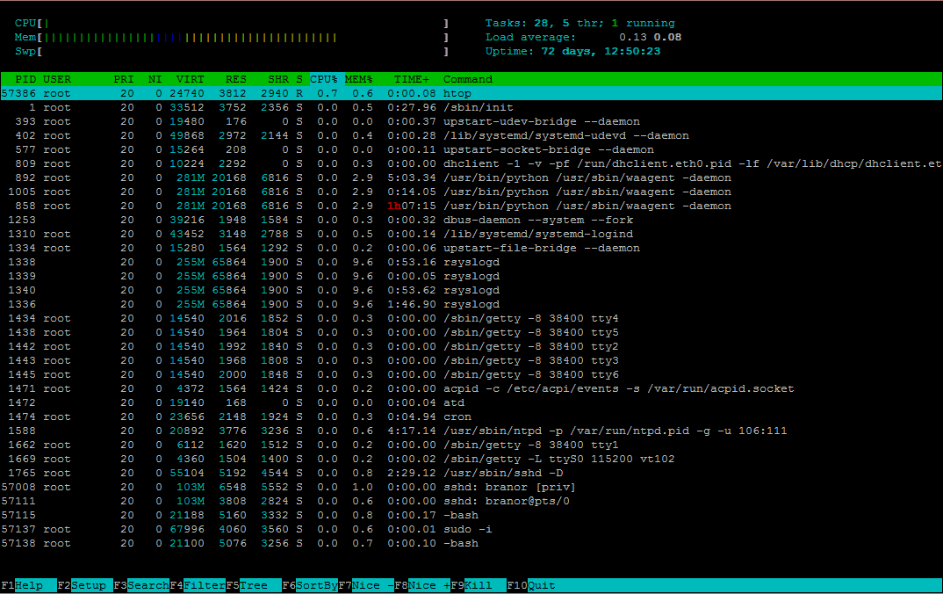
Server A

Slide 3
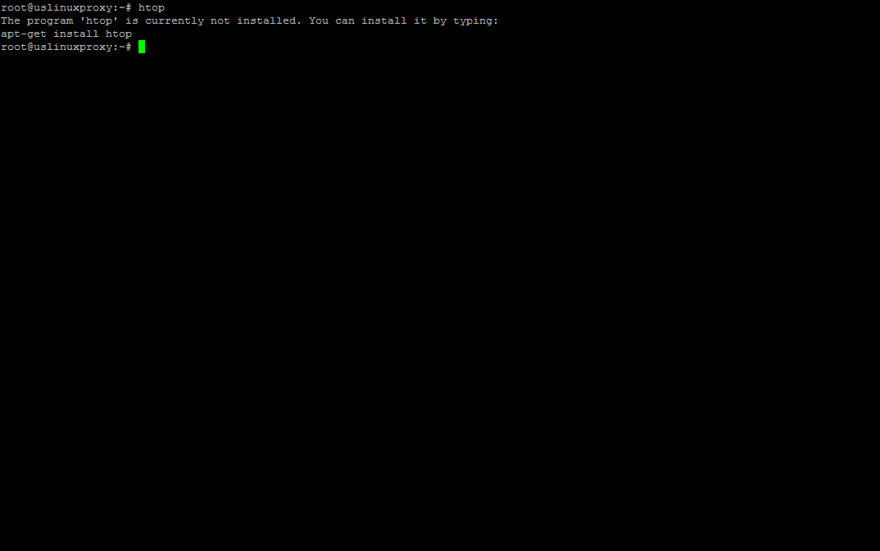
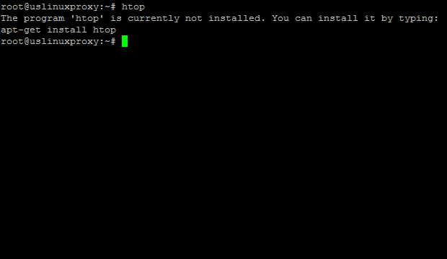
Server B

Slide 4
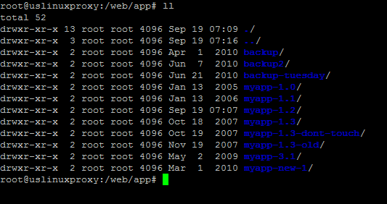
Web Server

Slide 5
Drift
Drift:
Differences between servers that should be identical
Causes:
Provisioning at different times
Updating scripts
Manual operations: debugging, updates, etc.
Meddling admins
Consequences:
Inconsistent behavior
Random failures
Gets progressively worse

Slide 6
Dealing with Drift
Manual:
“Our admin doesn’t make mistakes!”
Automation:
Can fail, has many edge cases, can drift over time
Configuration Management:
Helps, but only deals with what you’ve configured

Slide 7
Automation
Scripts themselves drift over time
Servers aren’t always in the same state
Unreachable
Fail during provisioning
Other services aren’t always available
Package repository is down or unreachable
Code or artifact repository is unavailable

Slide 8
Configuration Management
package{"openssl":ensure=>"installed"}
A wild OpenSSL vulnerability appears!
package{"openssl":ensure=>"1.0.1g"}
Something went wrong, abort, abort!
package{"openssl":ensure=>"installed"}
We didn't roll back to the previous version!
package{"openssl":ensure=>"1.0.1f"}
Let’s hope this works!

Slide 9
More Configuration Management
package{"openssl":ensure=>"1.0.1f"}
Package not found in the repository
No wait, we wanted an older version
The older version definitely isn’t found in the repository
No wait, we were actually using 0.9.8xxx
Upgrading to 1.0.1g upgraded the whole distro

Slide 10
Immutable Infrastructure to the Rescue
Never change what's on the server!
Don't install packages
Don't upgrade packages
Don't remove or downgrade packages
(Even for security vulnerabilities!)
Don't edit configuration files
Don't update your app code
(Even for small or urgent fixes!)

Slide 11

Immutable Infrastructure to the Rescue
If tempted to change something on the server
See previous slide!

Slide 12
Immutable Infrastructure to the Rescue
I’ll just fix one little thing…
See previous slide!

Slide 13
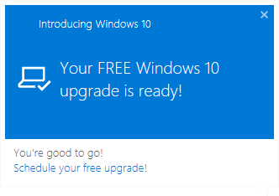
Upgrading with Immutable Servers
Create new server(s) from scratch
Run deployment process
Automation
Configuration Management
Test new server
Replace old server(s) with new
Don’t destroy old server(s)
Rollback if necessary

Slide 14

Uptime is a Liability
“Trash your Servers and Burn your Code”
– Chad Fowler, 2013
Reprovision regularly
Fixes drift automatically
Takes care of updating to recent dependencies
Handles restarts seamlessly
Notes:
The server on the first slide I showed had 72 days uptime. It’s my own private server and even I can’t remember what the hell I did with it in the past 3 months.

Slide 15
Downsides
Debugging is harder:
No debugging tools installed
Can’t fiddle with config
Logs are external
Solutions:
1: Bundle everything you need into the base image
2: Drift and destroy
Mark an instance to prevent re-imaging, debug things, destroy instance

Slide 16
Downsides
Small changes become expensive:
Create image
Provision new servers
Swap between old and new servers
Deprovision old servers
Solution:
Automate everything!
Still expensive in clock time, but saves user time

Slide 17
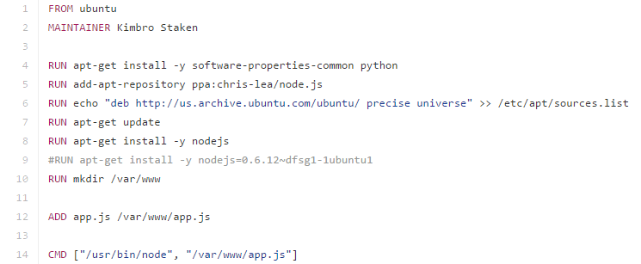
Downsides
Better solution: Containers with incremental snapshots
Notes:
If we use this as the base image, we can layer another dockerfile on top – docker will know to reuse the cache for commands that have already been executed (and haven’t changed).
Note: apt-get update should be combined with apt-get install on the same line, to prevent cache problems precisely because it won’t be re-run in a layered dockerfile.

Slide 18
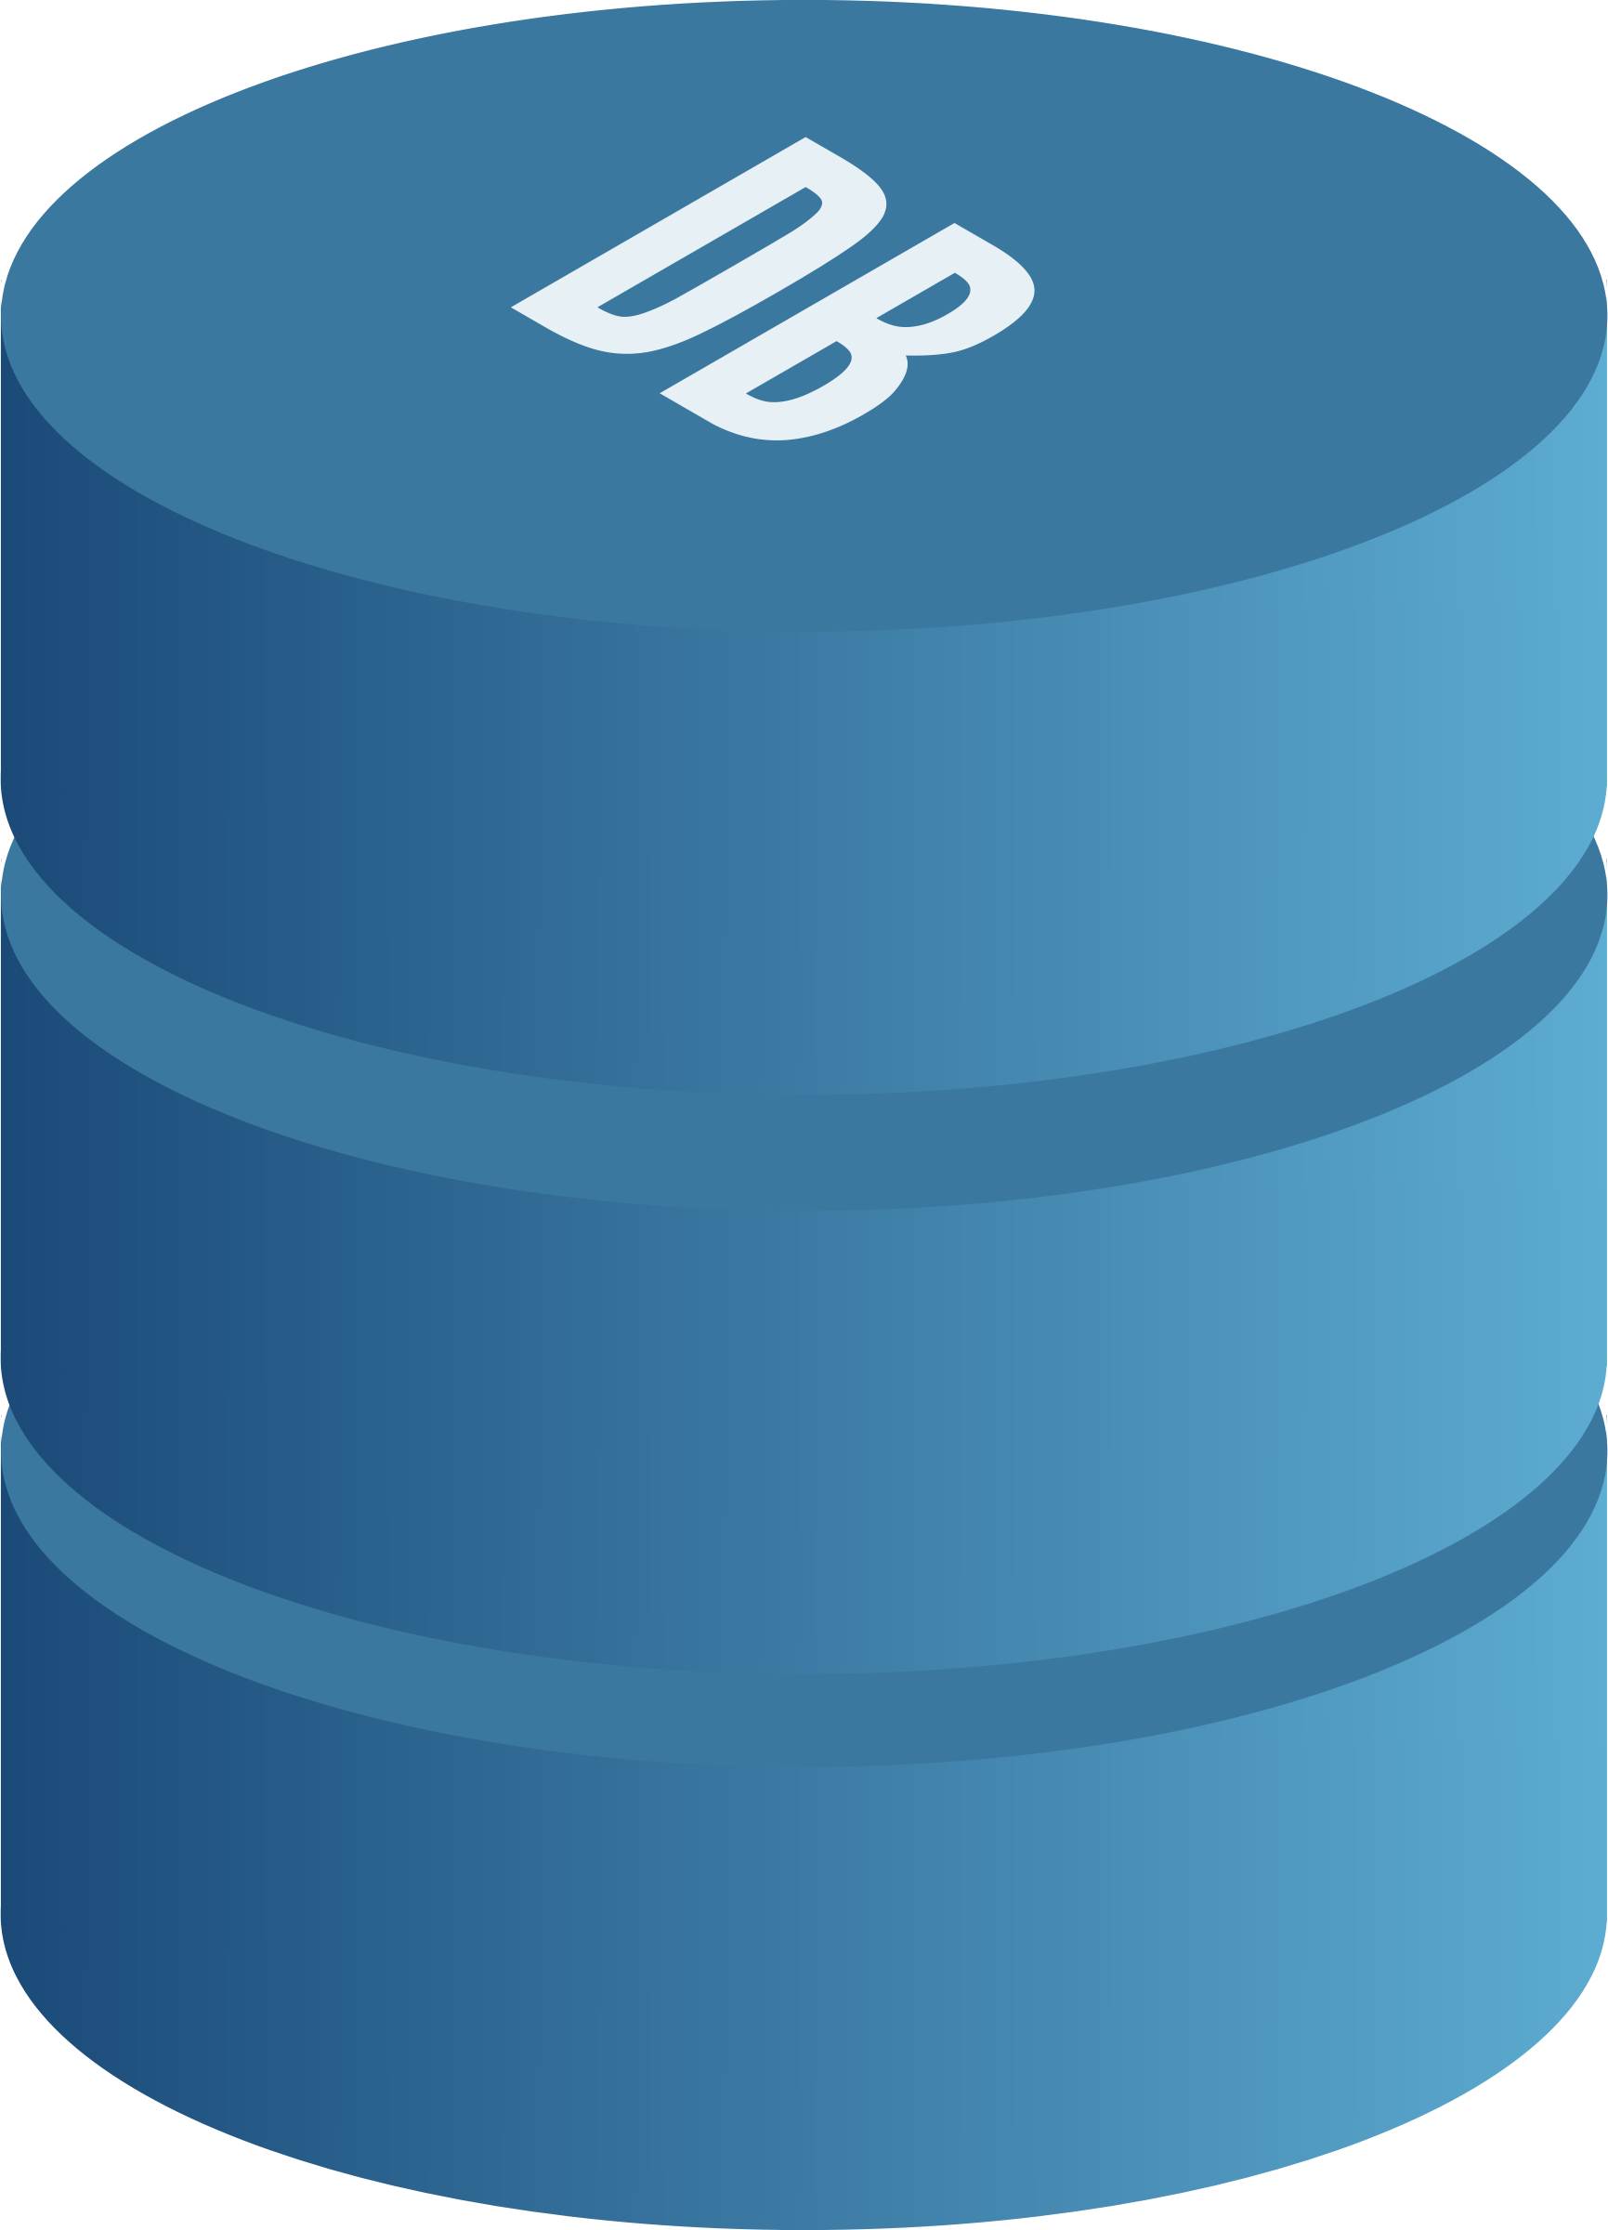
Dealing with State
Systems aren’t immutable, components are!
Decouple configuration and addressing
Minimize per-instance configuration
Pass configuration to containers on start
DNS, Consul, Etcd, Eureka, Zookeeper, etc.
Force mutable components (state) to be siloed
Databases, object stores, messaging (queues), etc.
Notes:
Of the top 10 most common technologies running on docker, 4 are data stores of some kind: Redis, Elasticsearch, MySQL, PostgreSQL. Most common image is Registry (makes sense) and 2nd most popular is NGINX.

Slide 19
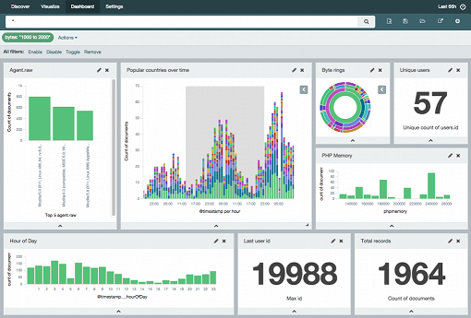
Log and Monitor Everything
Components are disposable, data isn’t!
Ship log data to a central location
Shared filesystem (NFS, EBS, etc.)
RSYSLOG
ELK
More…
Centralize monitoring and alerts!
Nagios, Zabbix, Grafana, etc.
AWS CloudWatch

Slide 20
Not for EVERYBODY
Some things don’t fit into the immutable mold:
Data processing frameworks
Storm, Spark Streaming, Kafka, etc., can’t be containerized easily
They are, in fact, container runtimes themselves

Slide 21
The Future
Pure function compute services?
AWS Lambda, Azure Functions, Google Cloud Functions, etc.
Continuous applications?
Spark 2.0, Flink

